Slide 1
Title
Week 1 – Website prototyping
Dr Fatmaelzahraa Eltaher
Date, Module name, Lesson number
Web Development 1

Slide 2
Learning outcomes for this lesson
Prototyping
High Fidelity and Low Fidelity Prototypes
Sketching
Storyboards
Wireframes
Laying out a page with HTML and CSS

Slide 3

When you hear the word prototype, what comes to mind?

Slide 4
Prototyping
Prototyping is the creation of a representation of the system to demonstrate the operation and functionality of the system.
The prototype can be used to demonstrate/test the system to the customer or stakeholder to ensure the requirements and the functionality are correct.

Slide 5
Types of prototyping
Low Fidelity Prototype
High Fidelity Prototype

Slide 6
Low fidelity prototype
A Low Fidelity (Lo-Fi) prototype can be created using a rough drawing on paper and whiteboards.
The Lo-Fi drawing or sketches are crude in appearance and are used to capture the structural design of the website.
The Lo-Fi sketch is not a complete representation of the design of the website. It just gives an overview of the structure and visual appearance of the content on the page.
They are faster to produce, allowing more variations in a short period of time

Slide 7
Advantages of low fidelity prototype
A cheap and quick way to design the structure of a system.
Gives a clear way to communicate the design of the site with all the stakeholders in the project. The client can be engaged in development of the Lo-Fi prototype and gives them a sense of ownership and engagement.
Lo-Fi prototypes are disposable.
No learning curve associated with creating Lo-Fi prototypes, anybody can do it
Gives a good overview of the complete system, by only giving minimal information on styling

Slide 8
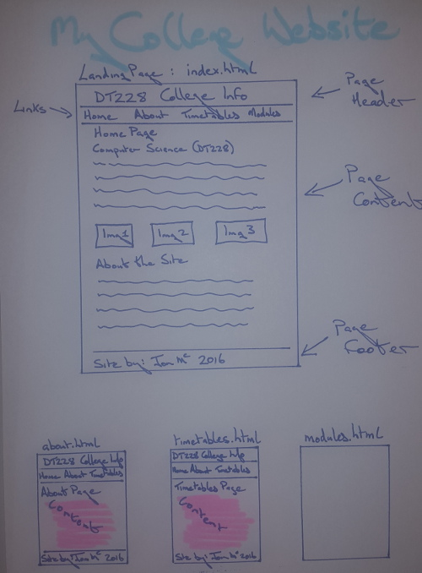

Slide 9
Low fidelity prototype
Examples:
Sketching
Wireframing
Storyboards

Slide 10
Sketching
Sketching can be used to initially capture the structure and content of the system.
This can be used to communicate with project stakeholders.
The sketches may not be appropriate to present to a customer for feedback (not professional looking)

Slide 11
Wireframe
A wireframe is used to design the structure of a website.
The wireframe shows where the functionality and content will reside on the page.
Wireframes contain no information about styling, it only contains structural information.
Simple tools such as Figma can be used to create wireframes.

Slide 12
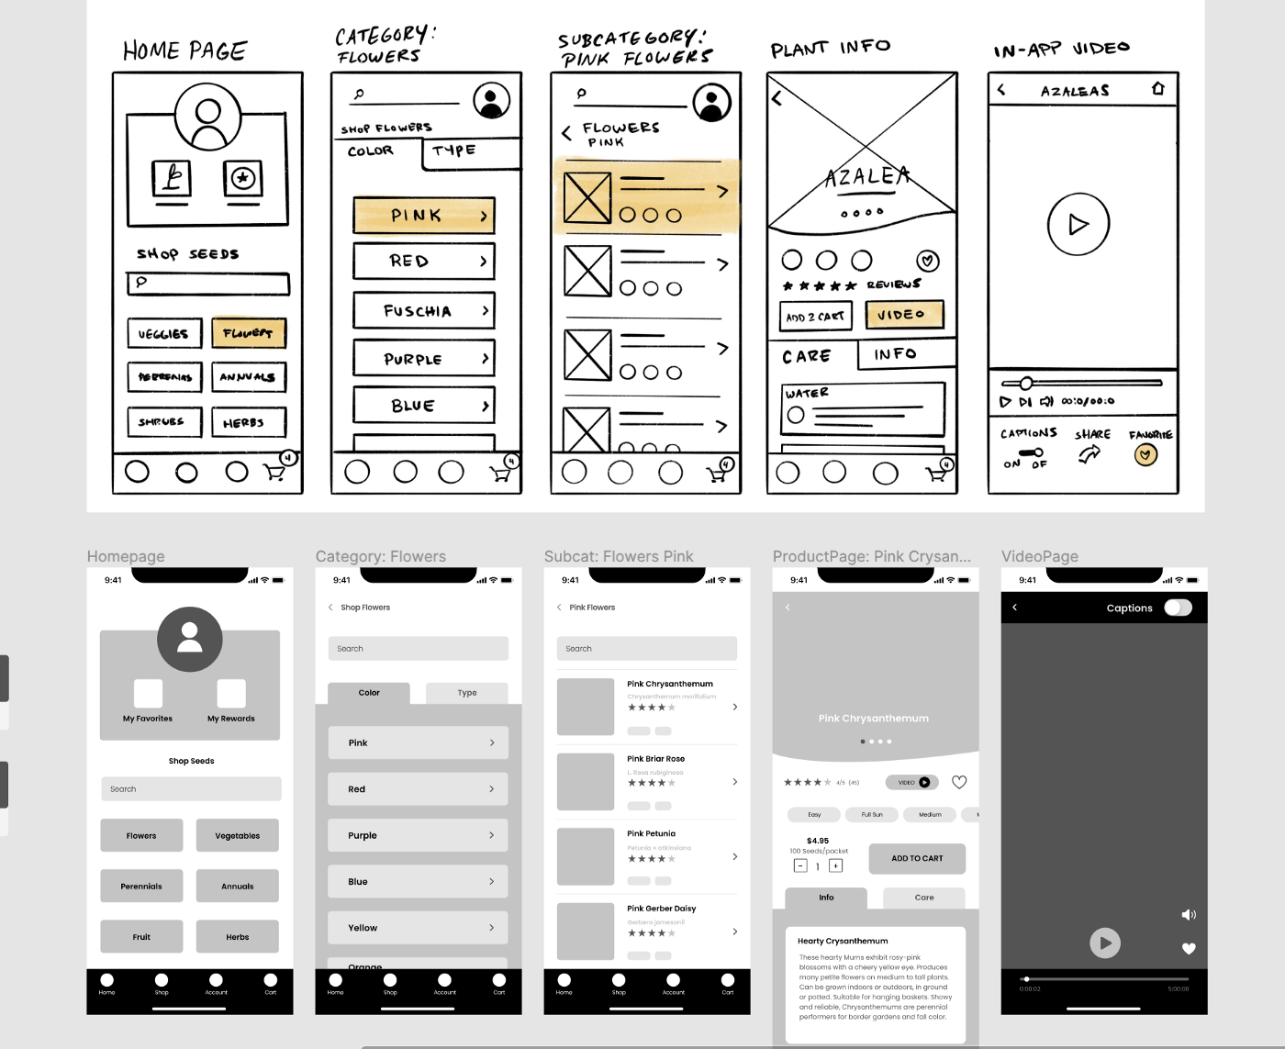
Wireframe

Slide 13
Storyboard
A storyboard is a sequence of illustrations displayed is a sequence to show how a user can perform a specific task.
Can be time consuming to create.
Can represent user interaction and application flow for a system.

Slide 14
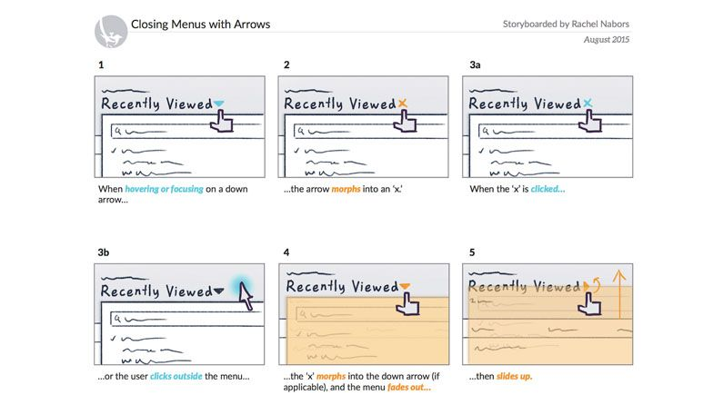
Storyboard

Slide 15
Task: Personal Homepage – Surprise Layout
“Sketch a quick layout for your personal homepage using only boxes and labels (no colors or fancy style). Your page must include all of the following elements, but you can place them anywhere you like:
Profile photo
Short bio/About Me
Navigation menu (at least 3 items)
Contact area (email or social links)
Featured quote or motto
Mini photo gallery (3–4 images or icons)
Fun fact box (one interesting detail about you)

Slide 16
High fidelity prototype
High Fidelity prototypes are created using computing tools.
They are very professional looking and contain a good level of detail.
The Hi-Fi prototype is a working demo of the system.
Examples created using Dreamweaver, Balsamiq
More details, providing more clarity for those viewing the prototype
Notes:
Very detailed, close to the final product.
Includes colors, fonts, interaction, and realistic content (like actual number of chairs, lighting, whiteboards in your classroom example).
High-Fidelity (Hi-Fi) Prototype
Meaning: A detailed, interactive mock-up that looks and behaves almost like the final product.
Goal: To let stakeholders test the design, layout, and user flows before full development.

Slide 17
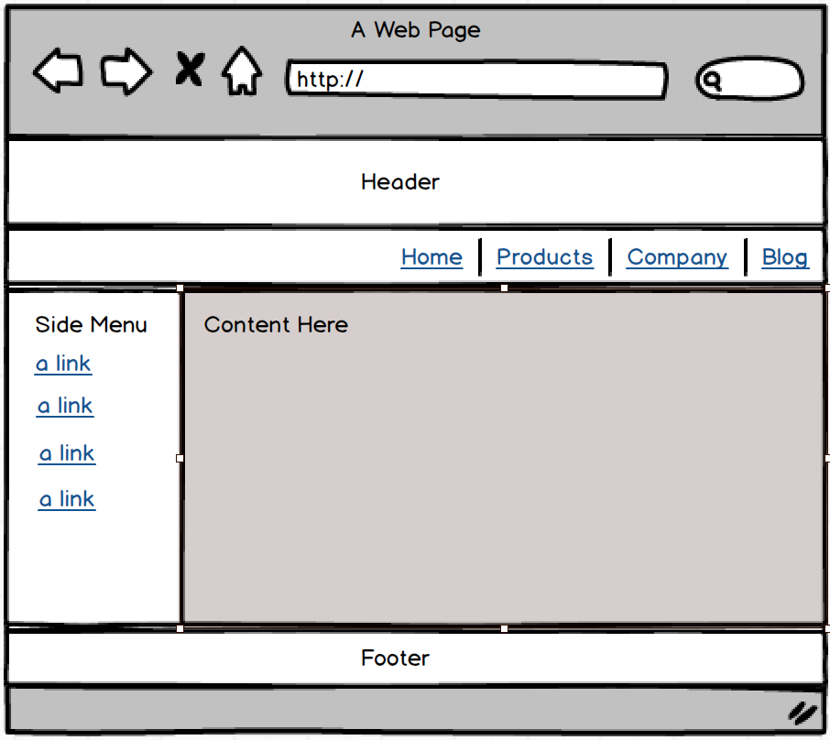
Laying out a page
Once we have our protypes, it is possible to start implementing the layout of a page using HTML and CSS
For example, check the following wireframe and click on the link to see a basic layout based on that wireframe:
Link to the layout implementation:
https://codepen.io/fatma_eltaher/pen/myewVQY

Slide 18
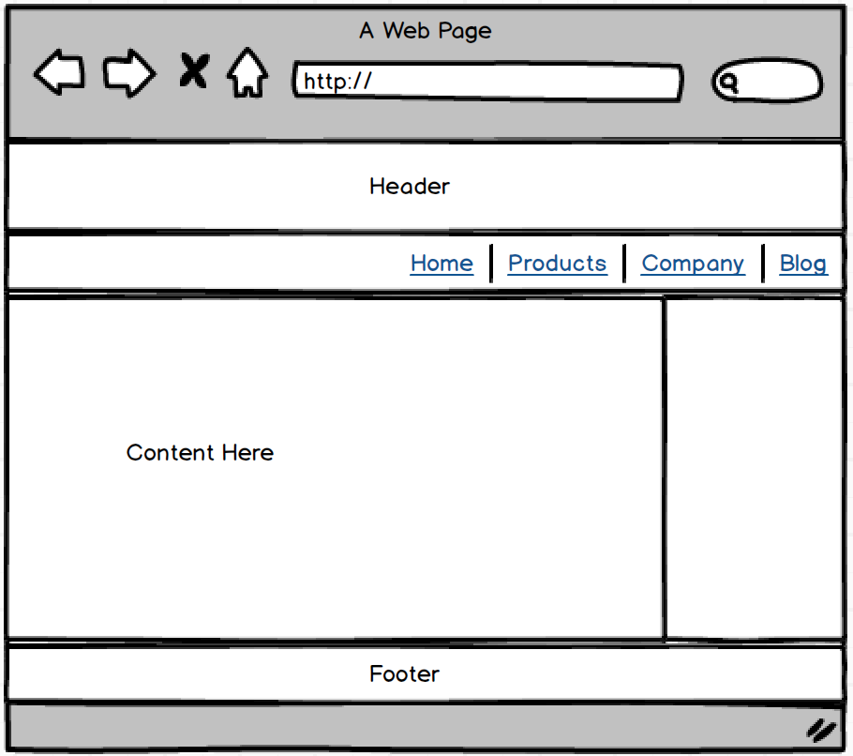
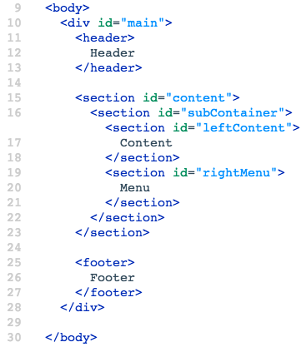
Laying out a page – Example 2

Slide 19
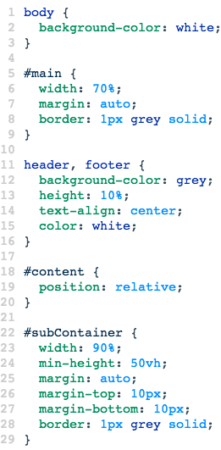
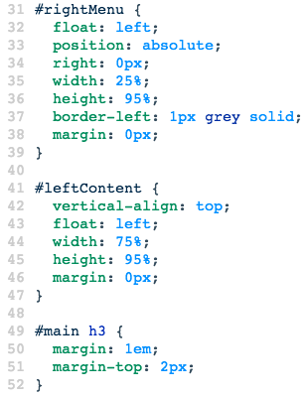
Laying out a page – Example 2

Slide 20
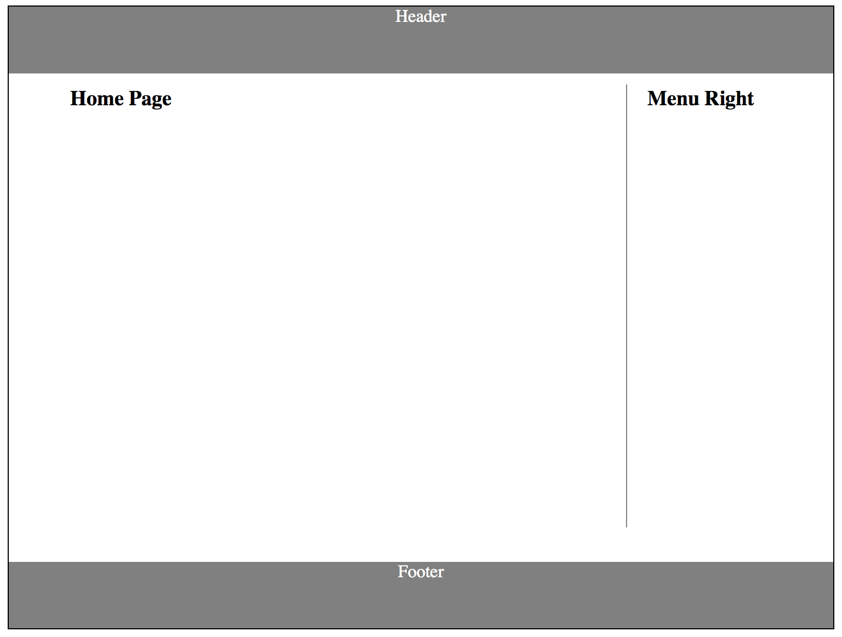
Laying out a page – Example 2

Slide 21
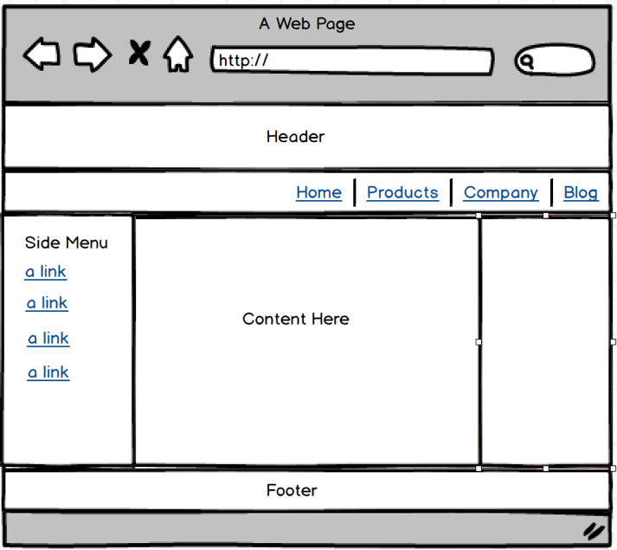
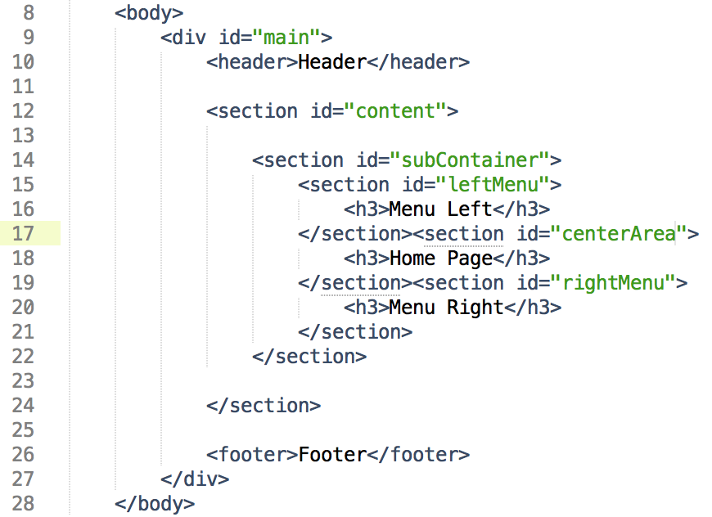
Laying out a page – Example 3

Slide 22
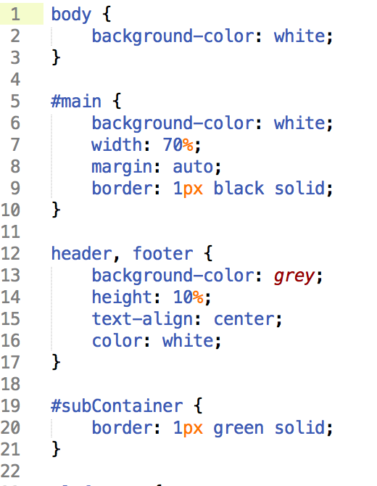
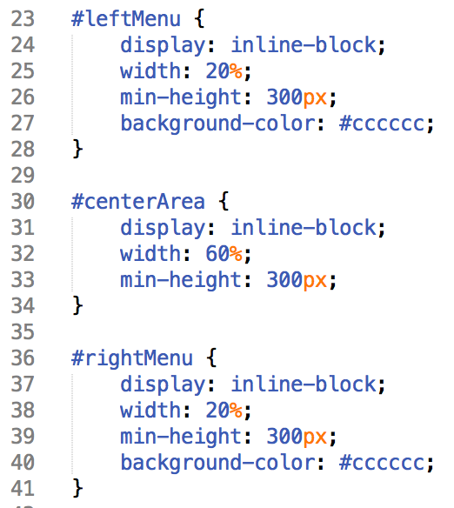
Laying out a page – Example 3

Slide 23
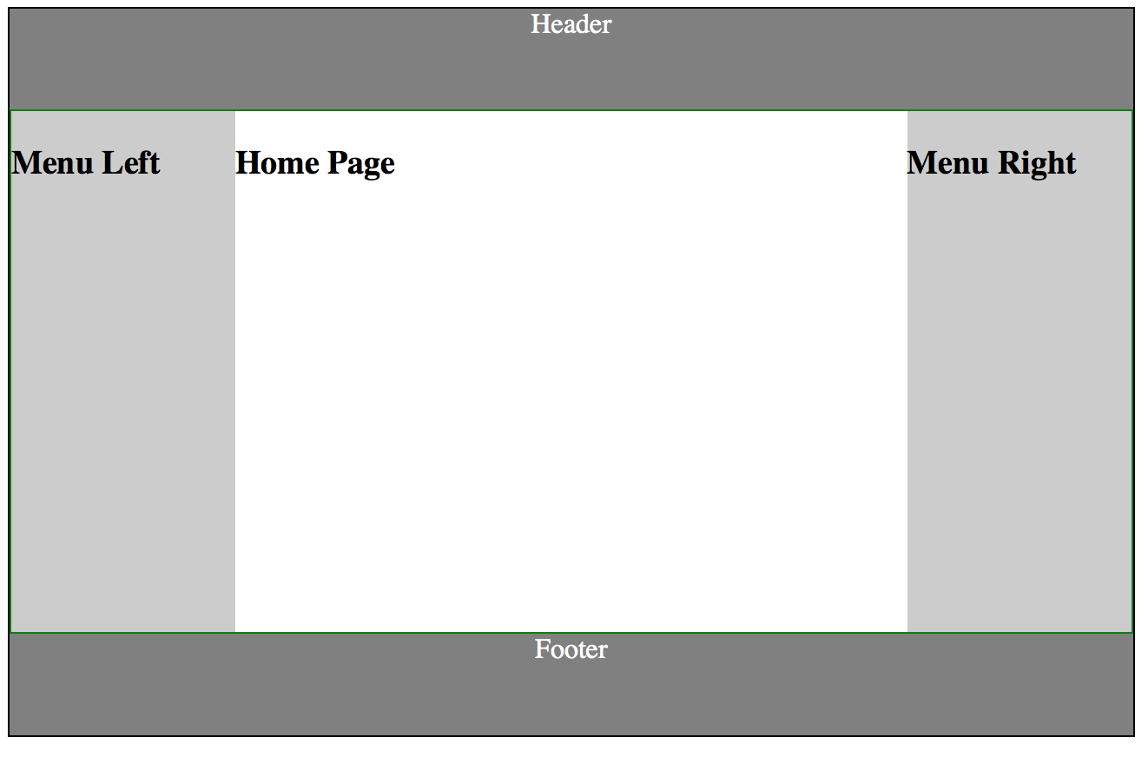
Laying out a page – Example 3

